Slide 1
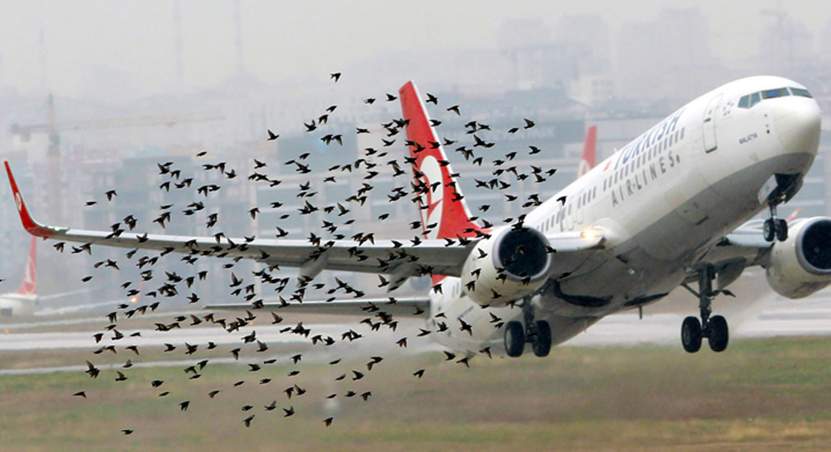
Data Visualization of Bird Strikes
Between 2001-2011
Project Report by
Pragnya

Slide 2
Project Details
Project Title | Data Visualization of Bird Strikes between 2000 – 2011
Technologies | Data Science
Domain | Transportation and Communication
Project Difficulties level | Advanced

Slide 3
Problem Statement
Transport and communication are in the crucial domain in the field of analytics.
Environmental impacts and safety are, nowadays, two major concerns of the scientific
community with respect to transport scenarios and to the ever-growing urban areas.
These issues gain more importance due to the increasing amount of vehicles and
people. Seeking new solutions is reaching a point where available technologies and
artificial intelligence, especially MAS, are being recognized as ways to cope with and
tackle these kinds of problems in a distributed and more appropriate way.
A bird strike is strictly defined as a collision between a bird and an aircraft which is in
flight or on a take-off or landing roll. The term is often expanded to cover other wildlife
strikes - with bats or ground animals. Bird Strike is common and can be a significant
threat to aircraft safety. For smaller aircraft, significant damage may be caused to the
aircraft structure and all aircraft, especially jet-engine ones, are vulnerable to the loss
of thrust which can follow the ingestion of birds into engine air intakes. This has
resulted in several fatal accidents.
Bird strikes may occur during any phase of flight, but are most likely during the
take-off, initial climb, approach and landing phases due to the greater numbers of birds
in flight at lower levels. To have a closer look the following document visually depicts
the data collected on Bird Strikes by FAA between 2000-2011.

Slide 4
Dataset Information
Objective
The objective of this project is to analyse and visualize bird strike data to identify patterns, high-risk areas, and impacts, and to provide insights for improving aviation safety.
The dataset covers bird strike incidents from 2000-2011, with 24,750 records detailing the date, location, weather conditions, flight phase, altitude, aircraft and airline involved, damage incurred, cost implications, and pilot warnings.

Slide 5
Architecture
Raw Data Collection
Importing Libraries In Jupyter Notebook
Load Dataset
Missing Values Imputation
Report
Data Pre-Processing
Data Cleaning
Handling Outliers
Insight
PowerBi
Desktop
Exploratory Data Analysis (EDA)

Slide 6
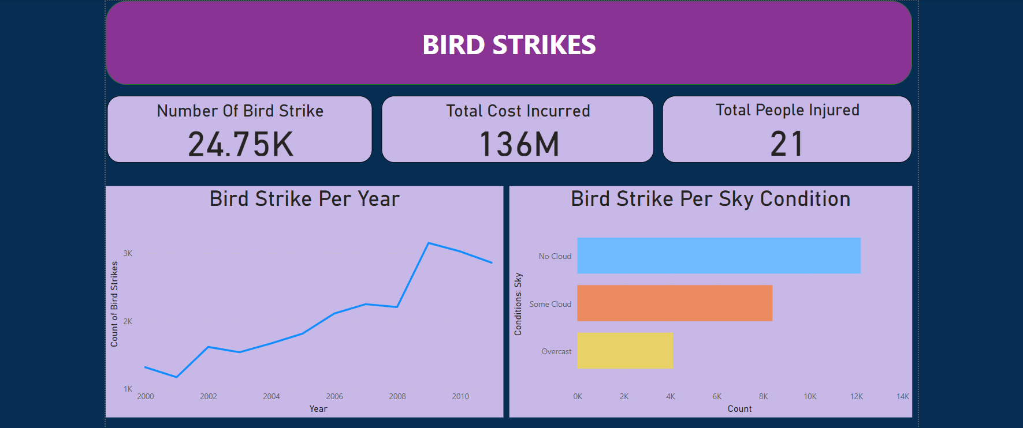

Slide 7
Key Findings
Total Number of Bird Strikes:
The data shows a total of 24,750 bird strike incidents, highlighting the frequency and impact of bird strikes on aviation.
Total Cost Incurred:
The financial impact of bird strikes is significant, with total costs amounting to $136 million. This includes damage to aircraft and other related expenses.
Total People Injured:
There have been 21 reported injuries due to bird strikes, emphasizing the potential risk to human safety.
Bird Strikes Per Year:
The trend analysis indicates an increase in bird strikes over the years, with a notable rise after 2008. This could be due to increased air traffic or changes in bird populations and behaviours.
Bird Strikes Per Sky Condition:
The majority of bird strikes occurred under clear (no cloud) conditions, with fewer incidents reported during some cloud and overcast conditions. This suggests that bird activity might be higher during clear weather.

Slide 8
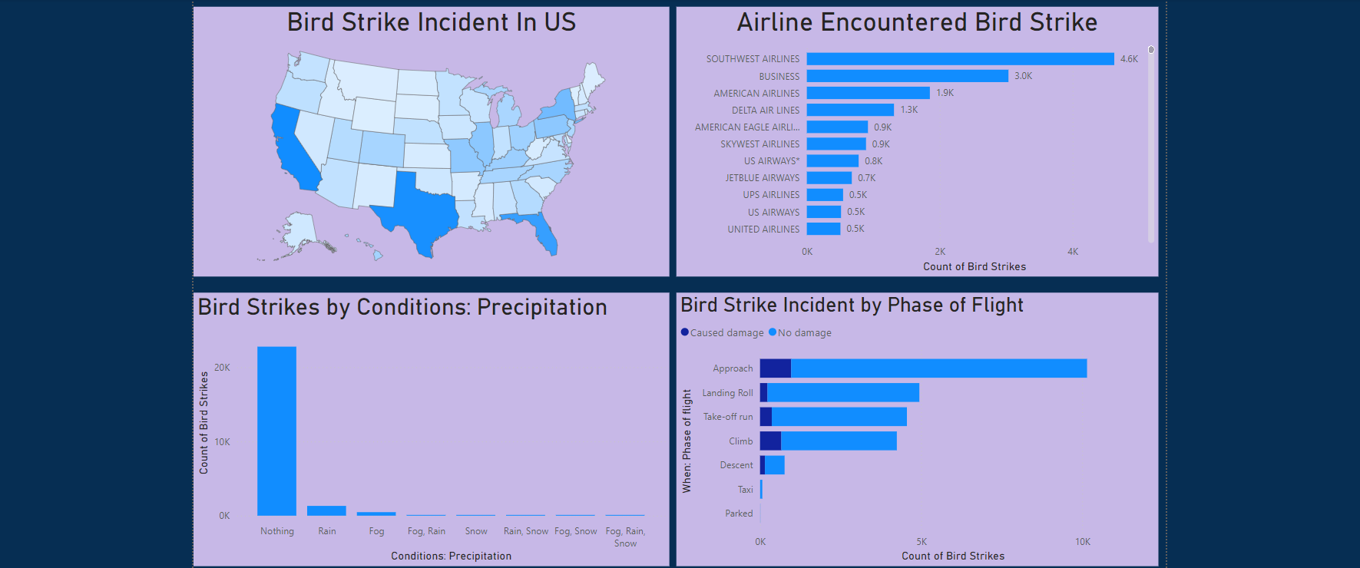

Slide 9
Geographical Distribution of Bird Strikes in the US:
The map shows that certain states, such as California and Florida, experience a higher frequency of bird strikes. This information can help target preventive measures in high-risk areas.
Airlines Encountered Bird Strikes:
Southwest Airlines has the highest number of bird strikes at 4,600, followed by American Airlines with 1,900, and Delta Air Lines with 1,300. This indicates that bird strikes are a common issue across major airlines, necessitating industry-wide strategies for mitigation.
Bird Strikes by Conditions: Precipitation:
Majority in Clear Conditions: Most bird strikes occur under clear conditions (no precipitation).
Minimal Strikes in Adverse Weather: Very few incidents are reported during rain, fog, snow, or combined conditions.
Bird Strike Incidents by Phase of Flight:
High Incidence During Approach: The highest number of bird strikes occurs during the approach phase.
Significant Incidents During Landing and Take-off:
Landing roll and take-off run phases also show a considerable number of bird strikes.

Slide 10
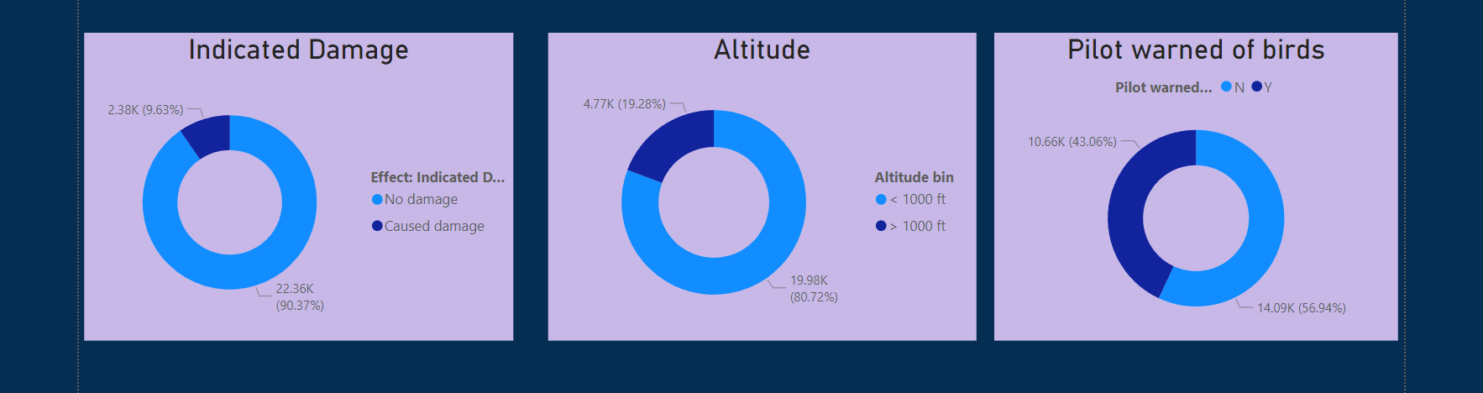
Indicated Damage:
Majority Cause No Damage: 90.37% of bird strikes do not cause damage.
Some Cause Damage: 9.63% of bird strikes result in damage to the aircraft.
Altitude of Bird Strikes:
Low Altitude (< 1000 ft): 80.72% of bird strikes occur at altitudes below 1000 feet.
Higher Altitude (> 1000 ft): 19.28% of bird strikes occur at altitudes above 1000 feet.
Pilot Warnings:
Warnings Before Strike: 56.94% of the time, pilots are warned about the presence of birds before the strike.
No Warnings: 43.06% of the time, there are no warnings issued to pilots before bird strikes.

Slide 11
Conclusion
The Bird Strike Data Visualization project reveals significant insights into bird strike incidents, highlighting key patterns and areas for improvement:
Increased Frequency: Bird strikes have become more frequent over the years, with a notable rise in recent years, indicating a growing concern for aviation safety.
Weather and Seasonal Trends: Most bird strikes occur under clear conditions, suggesting a need for enhanced monitoring during such weather. Additionally, certain months and weather conditions are more prone to bird strikes.
Geographical Hotspots: High-risk areas, particularly in specific states, require targeted mitigation strategies to reduce bird strike incidents.
Critical Flight Phases: The majority of bird strikes happen during approach and landing phases, emphasizing the need for increased vigilance during these critical flight stages.
Impact and Cost: While most bird strikes cause no damage, a significant number result in costs and damage to aircraft, underscoring the economic impact on airlines.
Altitude and Warnings: Most strikes occur at lower altitudes, with a substantial portion of incidents occurring without prior warning to pilots, highlighting the need for improved warning systems.

Slide 12
THANK YOU

